Slide 1

24CSA212 –
Full Stack Frameworks
Basics of HTML, CSS, and JavaScript -Introduction to MongoDB

Slide 2
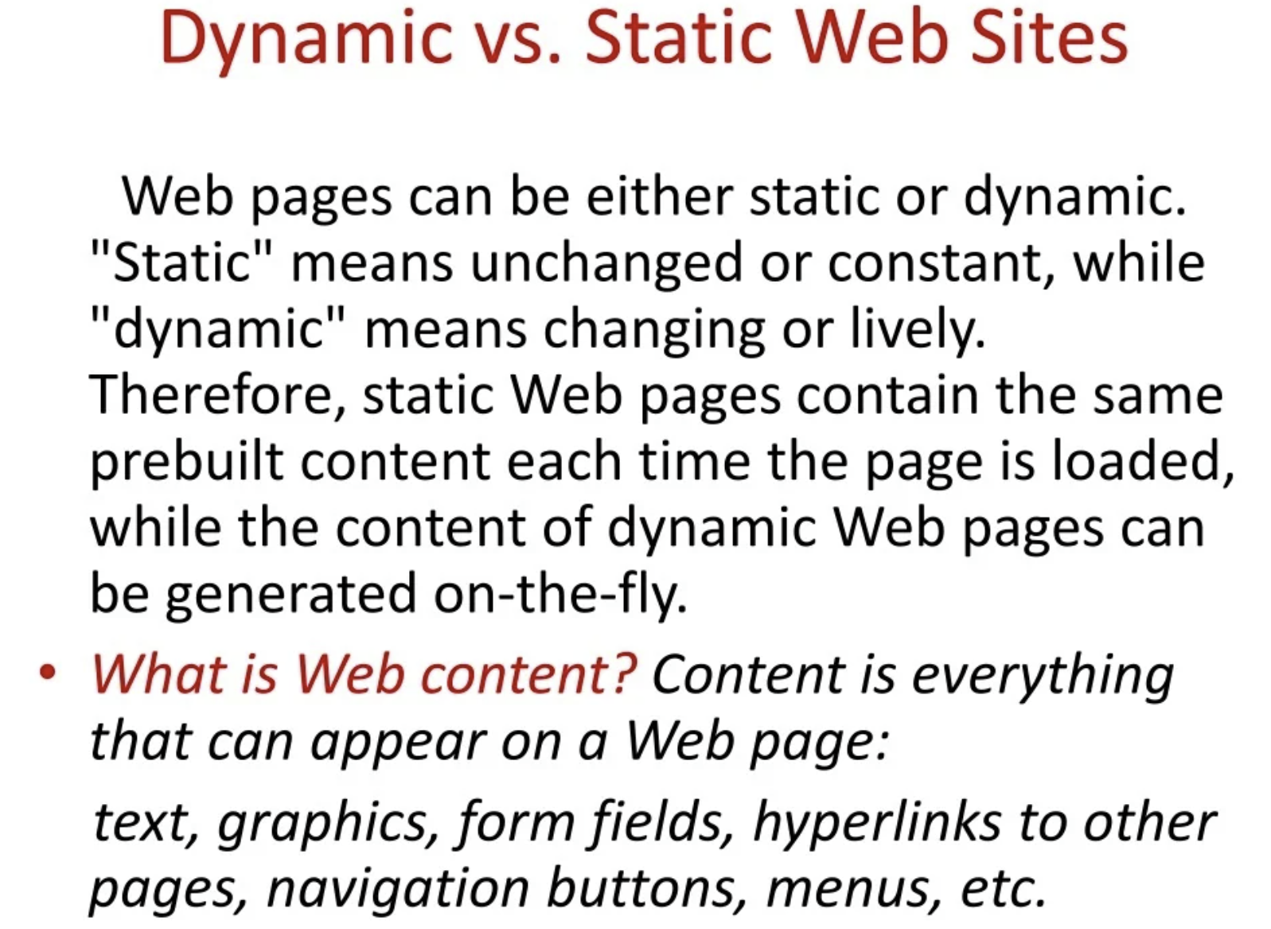

Slide 3
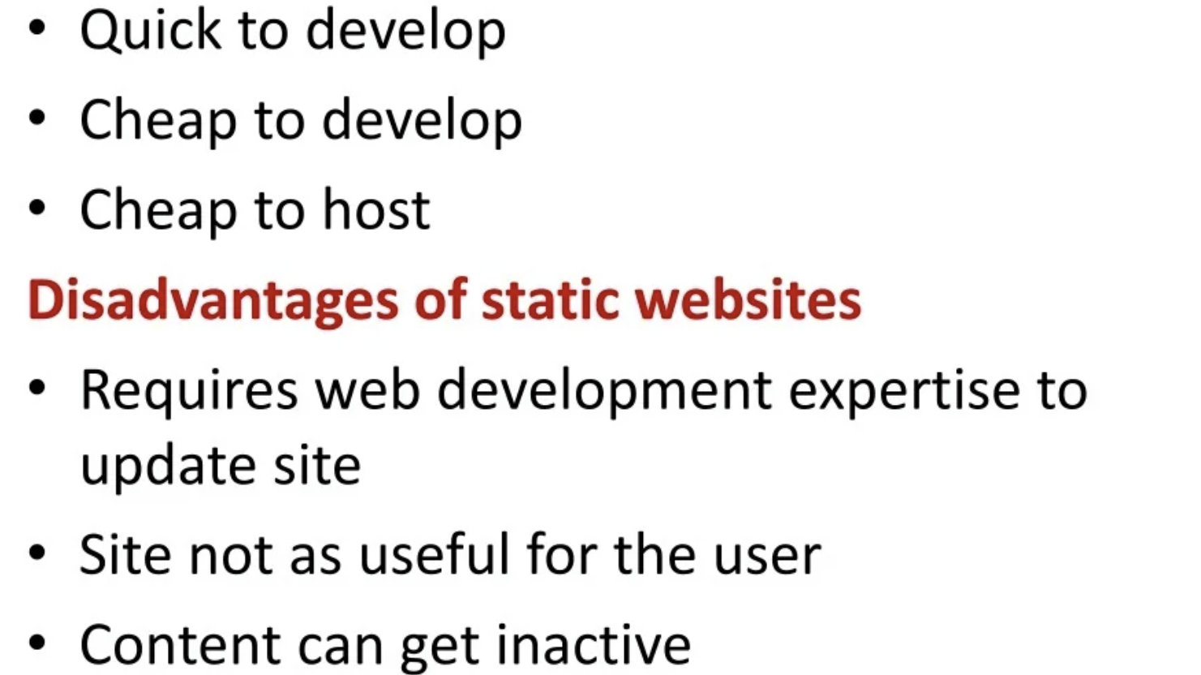

Slide 4
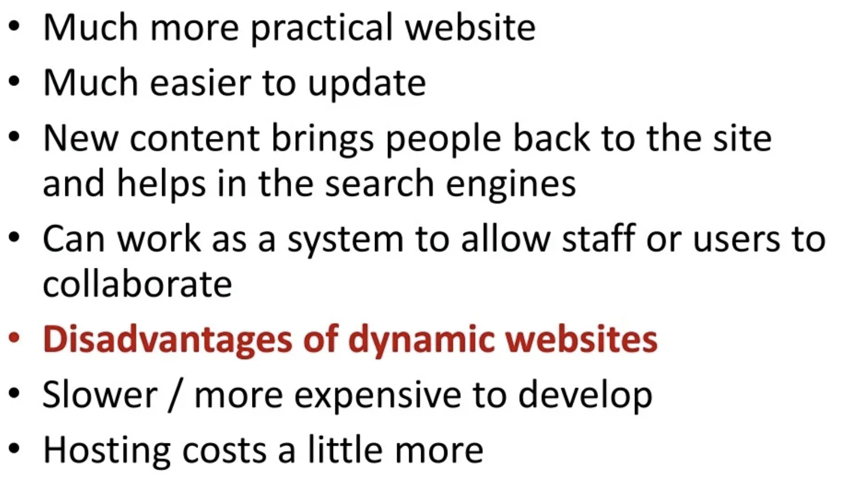

Slide 5
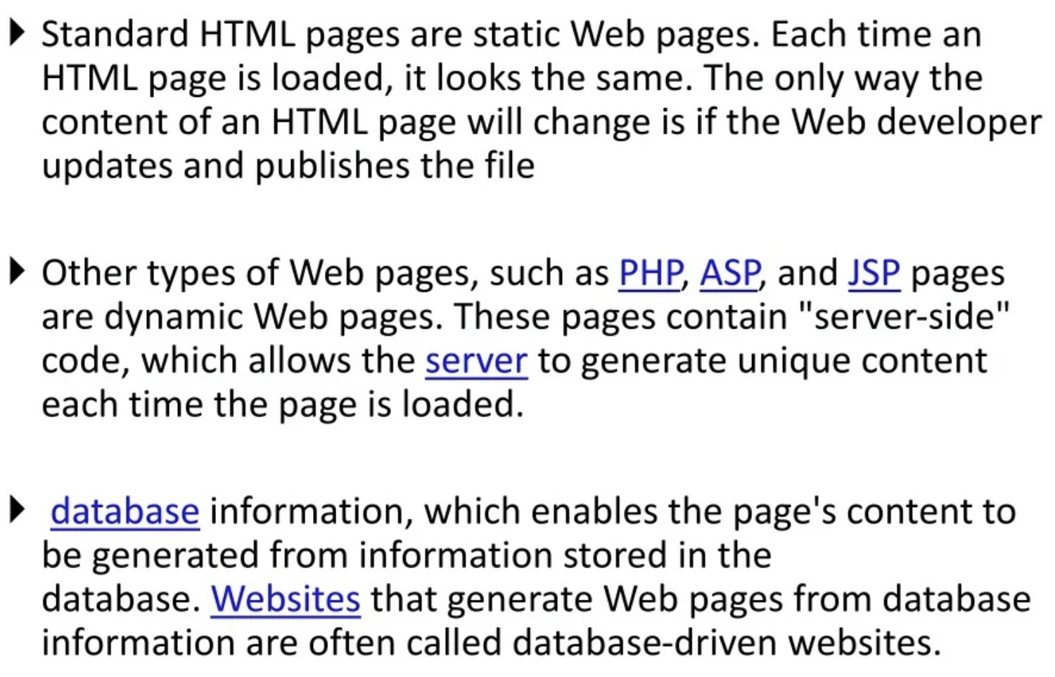

Slide 6
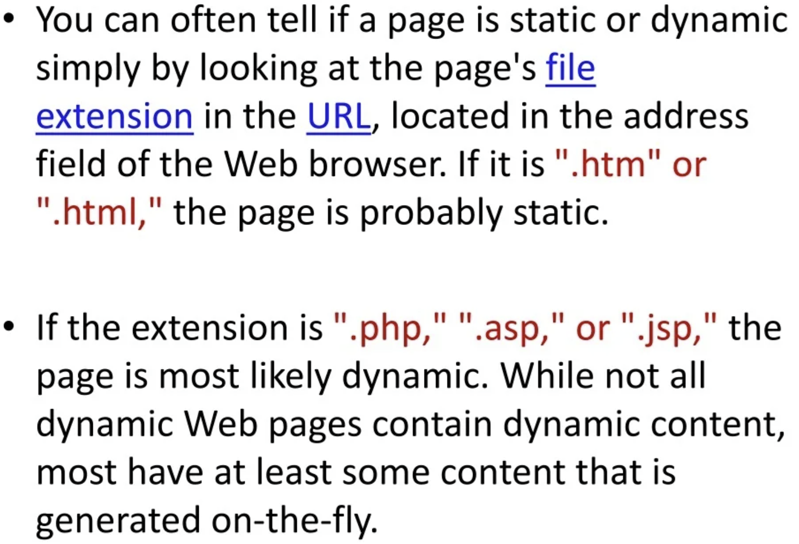

Slide 7


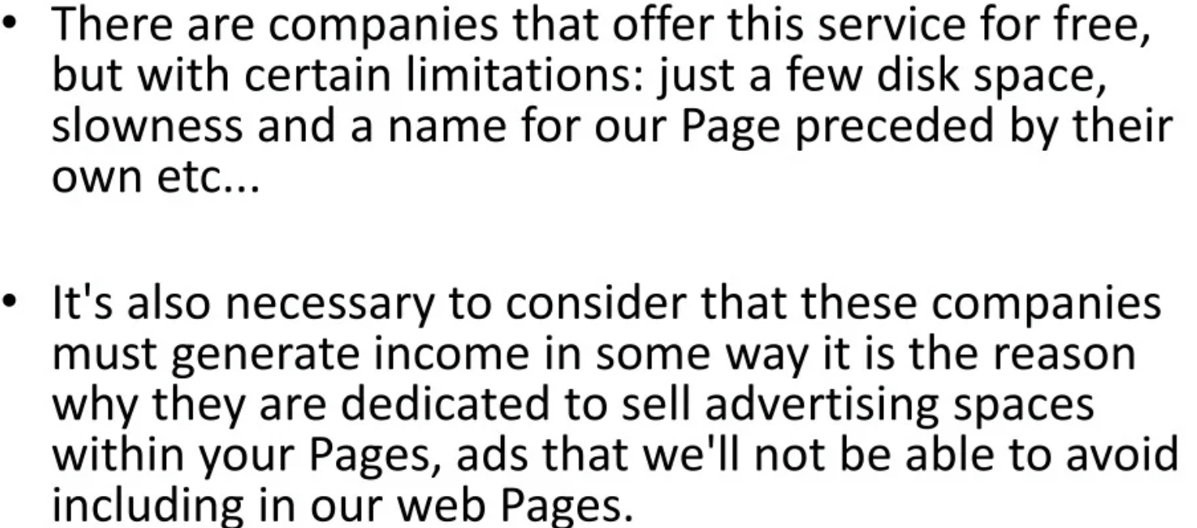

Slide 8
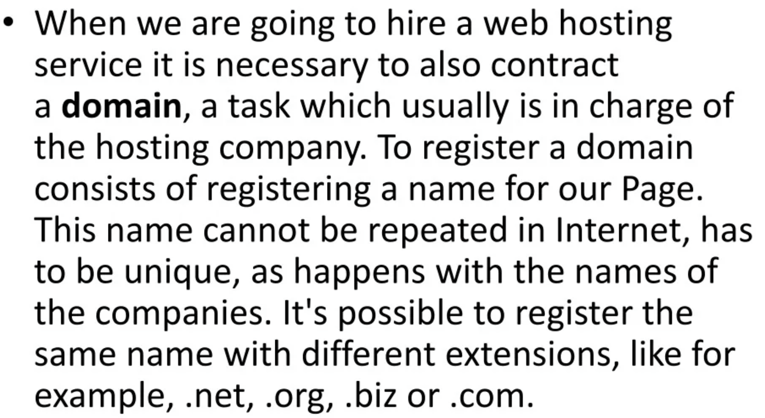

Slide 9
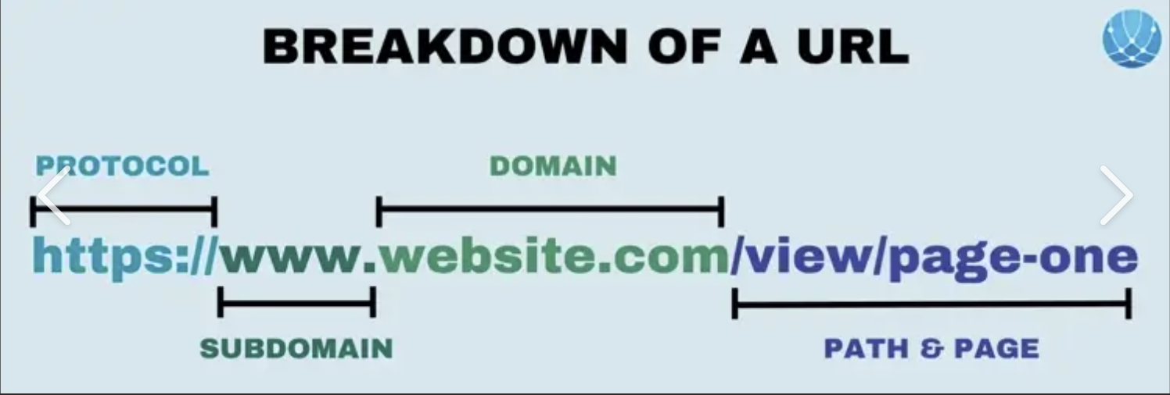

Slide 10
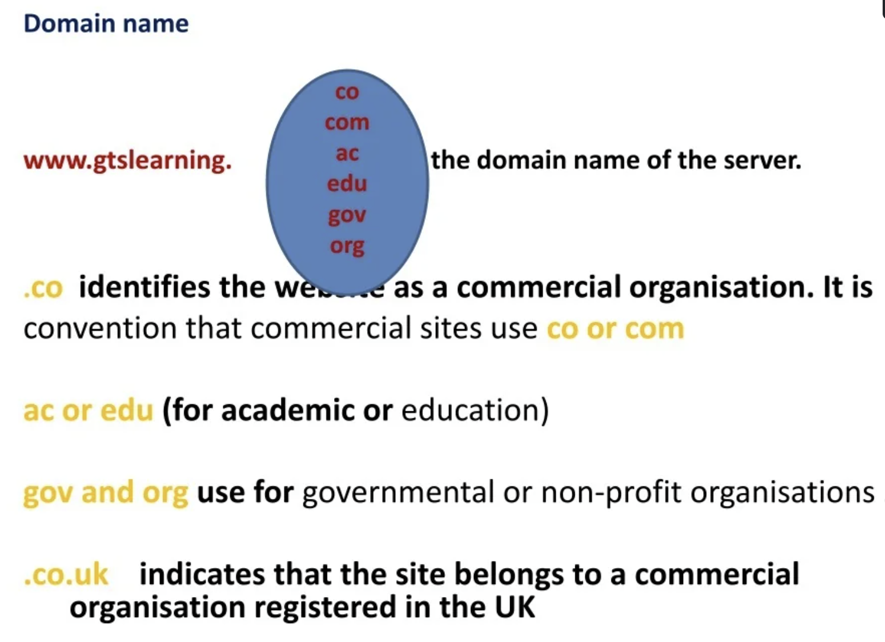

Slide 11
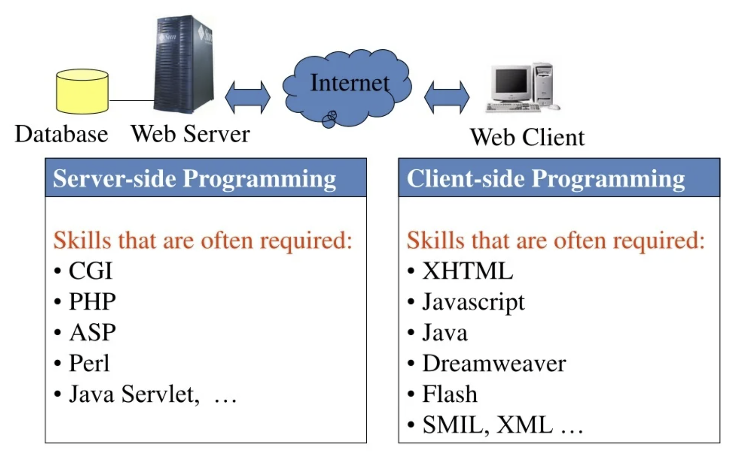

Slide 12

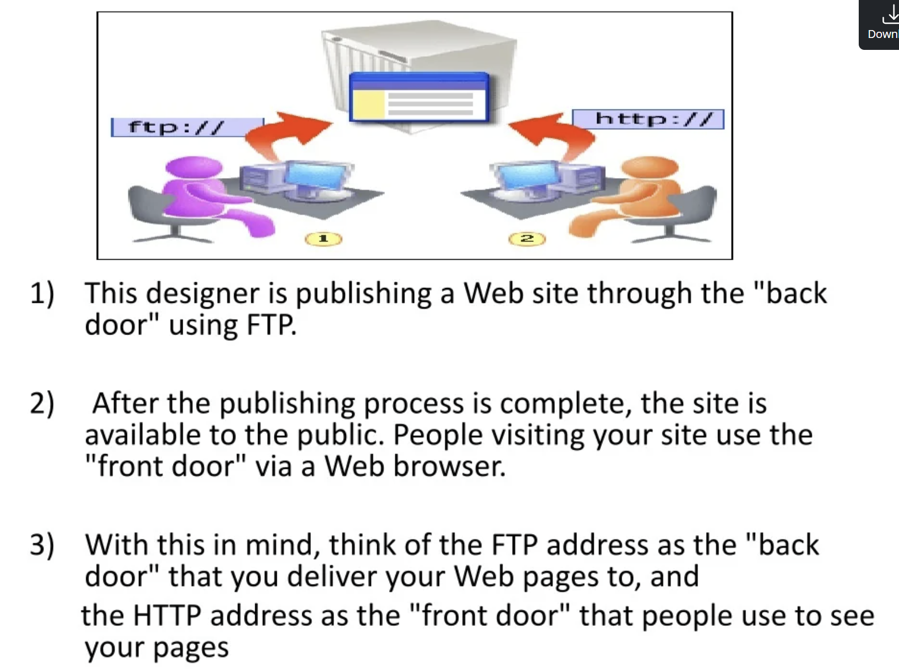

Slide 13
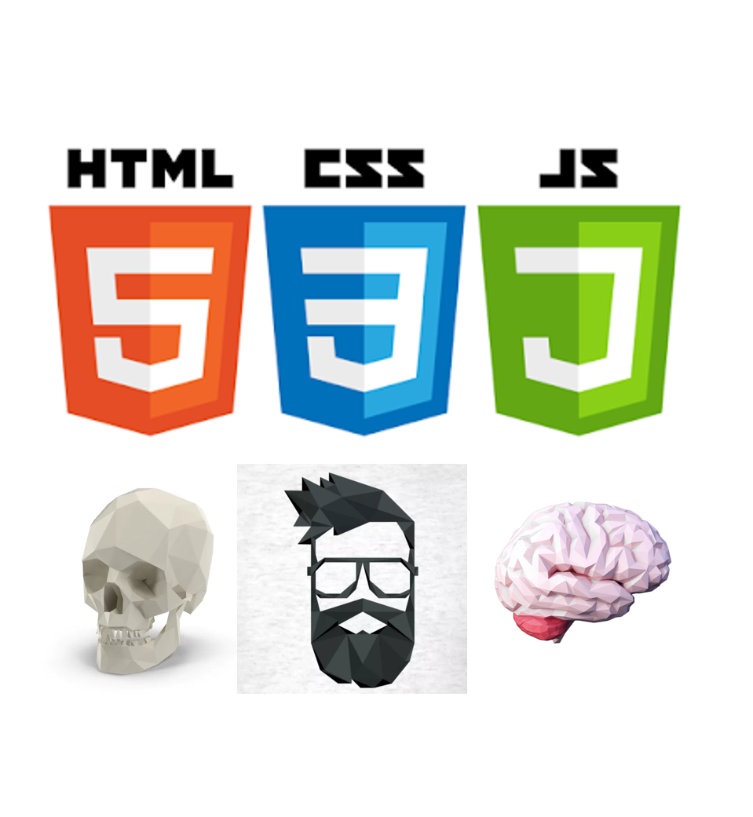
Introduction to web technologies:
HTML to create the document structure and content
CSS to control is visual aspect
Javascript for interactivity

Slide 14
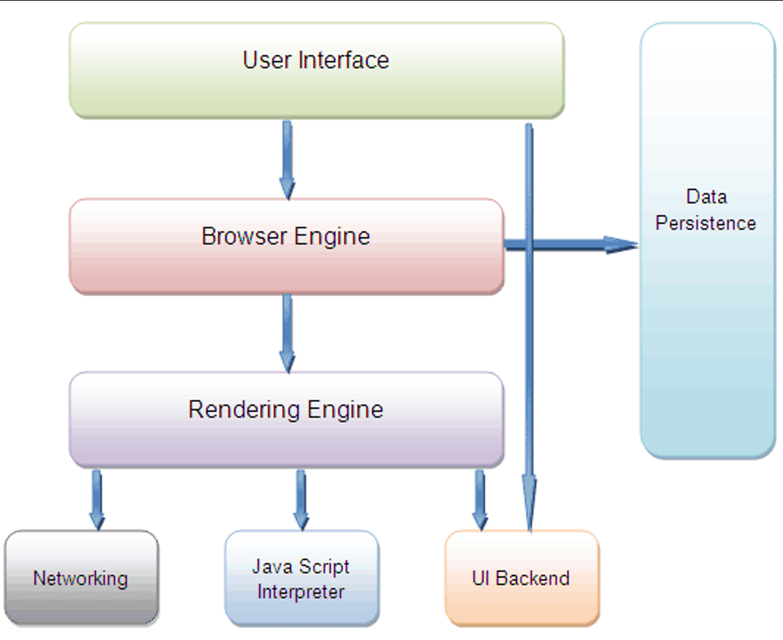
Inside a Browser
Browsers have very differentiate parts.
We are interested in two of them:
the Rendering Engine (in charge of transforming our HTML+CSS in a visual image).
The Javascript Interpreter (also known as VM), in charge of executing the Javascript code.

Slide 15

Markup language
There are many markup languages that add special tags into the text that the renderer wont show but use to know how to display the text.
In HTML this tags use the next notation:
My name is <b>XYZ</b>

Slide 16
HTML
HTML means Hyper Text Markup Language.
The HTML allow us to define the structure of a document or a website.
HTML is NOT a programming language, it’s a markup language, which means its purpose is to give structure to the content of the website, not to define an algorithm.
It is a series of nested tags (it is a subset of XML) that contain all the website information (like texts, images and videos).
Example:-
<title>This is a title</title>
The HTML defines the page structure. A website can have several HTMLs to different pages.
<html>
<head>
</head>
<body>
<div>
<p>Hi</p>
</div>
</body>
</html>

Slide 17
HTML: Basic rules
Some rules about HTML:
It uses XML syntax (tags with attributes, can contain other tags).
<tag_name attribute="value"> content </tag_name>
It stores all the information that must be shown to the user.
There are different HTML elements for different types of information and behaviour.
The information is stored in a tree-like structure (nodes that contain nodes inside) called DOM (Document Object Model).
It gives the document some semantic structure (pe. this is a title, this is a section, this is a form) which is helpful for computers to understand websites content.
It must not contain information related to how it should be displayed (that information belongs to the CSS), so no color information, font size, position, etc.

Slide 18
HTML: Syntax example
Tag name
attributes
<div id="main">
<!-- this is a comment -->
This is text without a tag.
<button class="mini">press me</button>
<img src="me.png" />
</div>
comment
text tag
self-closing tag

Slide 19
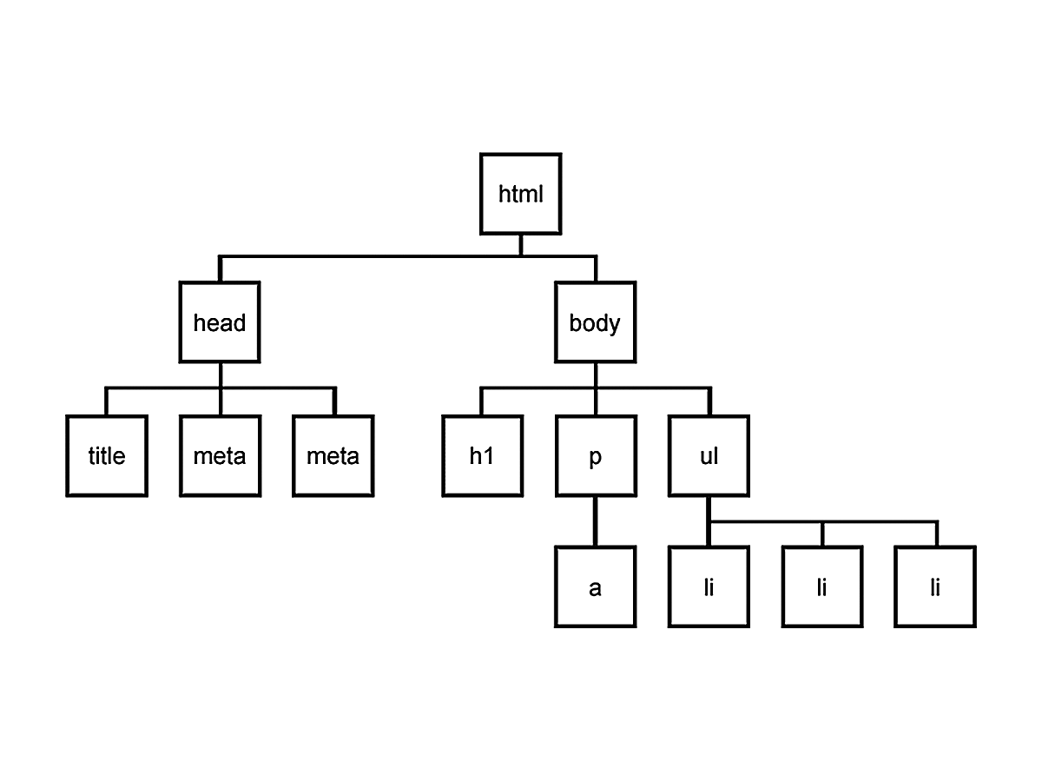
DOM is a tree
Every node can only have one parent, and every node can have several children, so the structure looks like a tree.

Slide 20
HTML: main tags
Although there are lots of tags in the HTML specification, 99% of the webs use a subset of HTML tags with less that 10 tags, the most important are:
<div>: a container, usually represents a rectangular area with information inside.
<img/>: an image
<a>: a clickable link to go to another URL
<p>: a text paragraph
<h1>: a title (h2,h3,h4 are titles of less importance)
<input>: a widget to let the user introduce information
<style> and <link>: to insert CSS rules
<script>: to execute Javascript
<span>: a null tag (doesn't do anything), good for tagging info

Slide 21
HTML: other tags
There are some tags that could be useful sometimes:
<button>: to create a button
<audio>: for playing audio
<video>: to play video
<canvas>: to draw graphics from javascript
<iframe>: to put another website inside ours

Slide 22
HTML references
HTML Reference: a description of all HTML tags.
The 25 Most used tags: a list with information of the more common tags.
HTML5 Good practices: some tips for starters

Slide 23
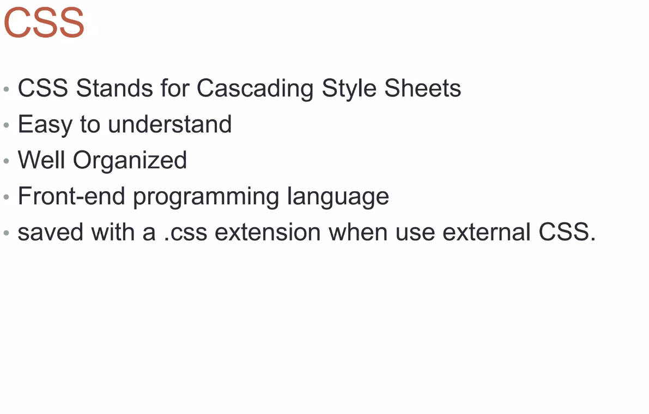

Slide 24
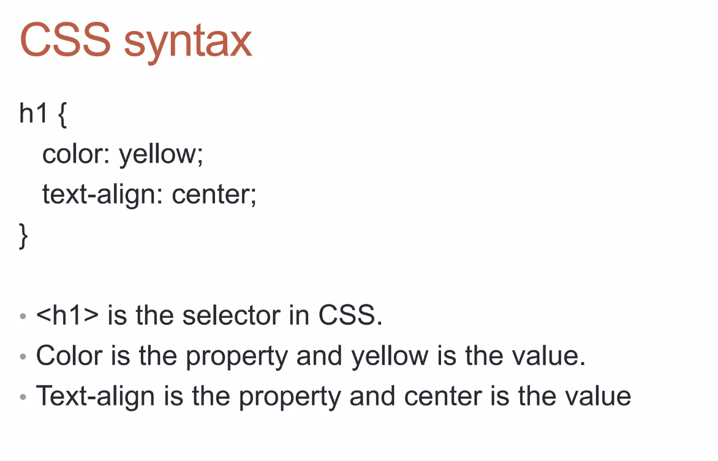

Slide 25
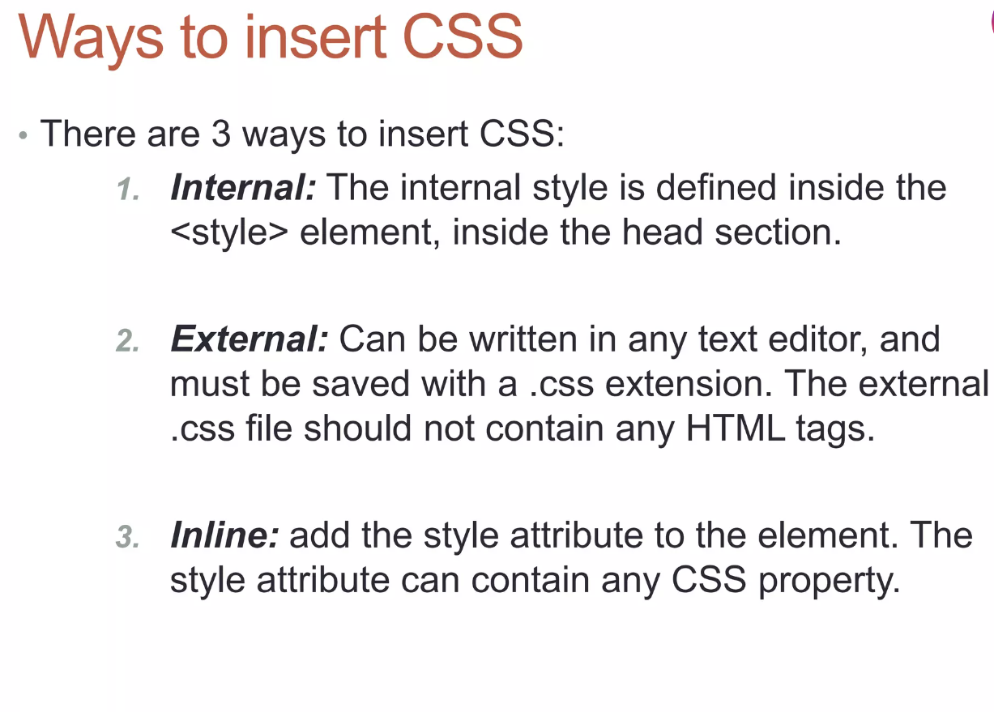

Slide 26
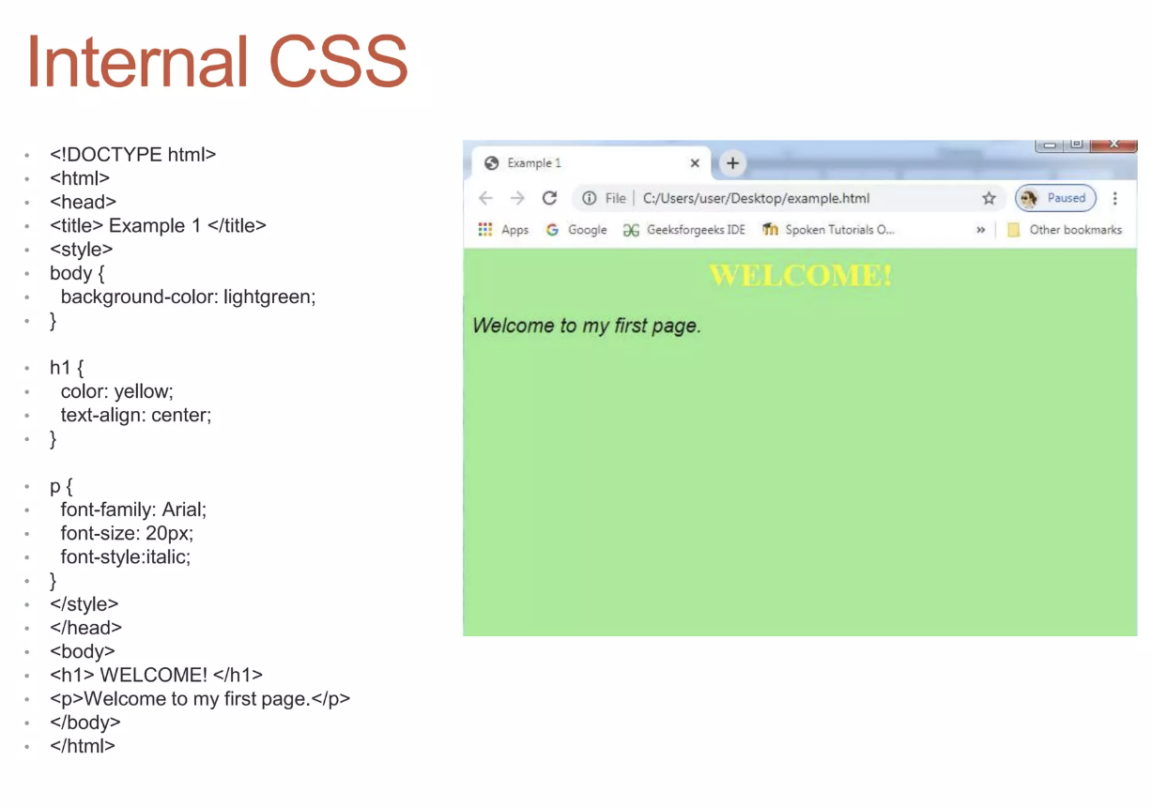

Slide 27
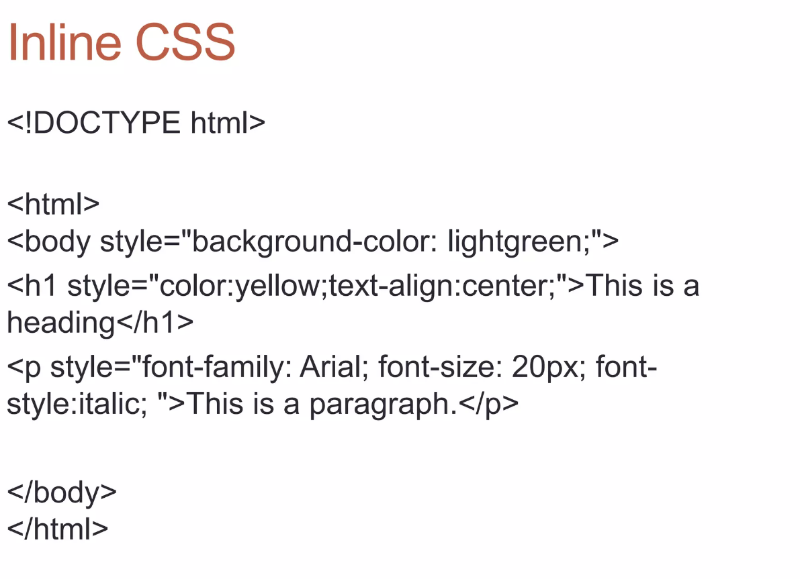

Slide 28
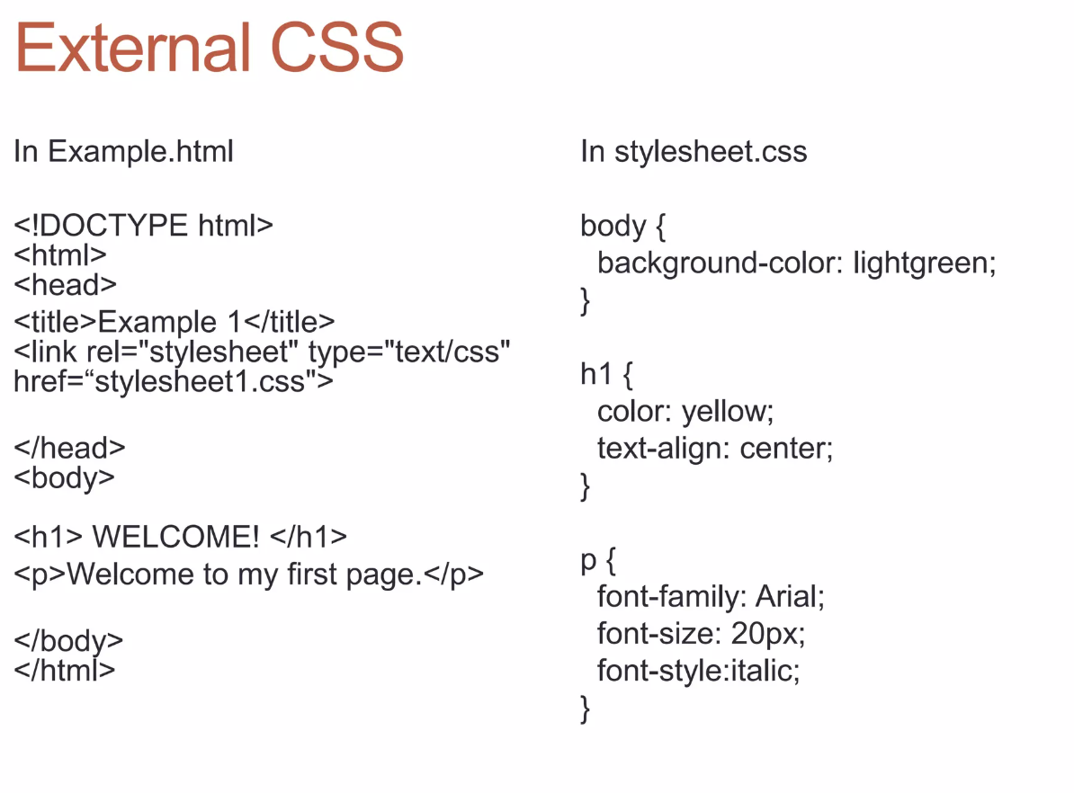

Slide 29
CSS fields
Here is a list of the most common CSS fields and an example:
color: #FF0000; red; rgba(255,00,100,1.0); //different ways to specify colors
background-color: red;
background-image: url('file.png');
font: 18px 'Tahoma';
border: 2px solid black;
border-top: 2px solid red;
border-radius: 2px; //to remove corners and make them more round
margin: 10px; //distance from the border to the outer elements
padding: 2px; //distance from the border to the inner elements
width: 100%; 300px; 1.3em; //many different ways to specify distances
height: 200px;
text-align: center;
box-shadow: 3px 3px 5px black;
cursor: pointer;
display: inline-block;
overflow: hidden;

Slide 30
CSS Selectors
There are several selectors we can use to narrow our rules to very specific tags of our website.
The main selectors are:
tag name: just the name of the tag
  p { ... } //affects to all <p> tags
dot (.): affects to tags with that class
  p.highlight { ... } //affects all <p> tags with class="highlight"
sharp character (#): specifies tags with that id
  p#intro { ... } //affects to the <p> tag with the id="intro"
two dots (:): behaviour states (mouse on top)
  p:hover { ... } //affects to <p> tags with the mouse over
brackets ([attr='value']): tags with the attribute attr with the value 'value'
  input[type="text"] {...} // affects to the input tags of the type text

Slide 31
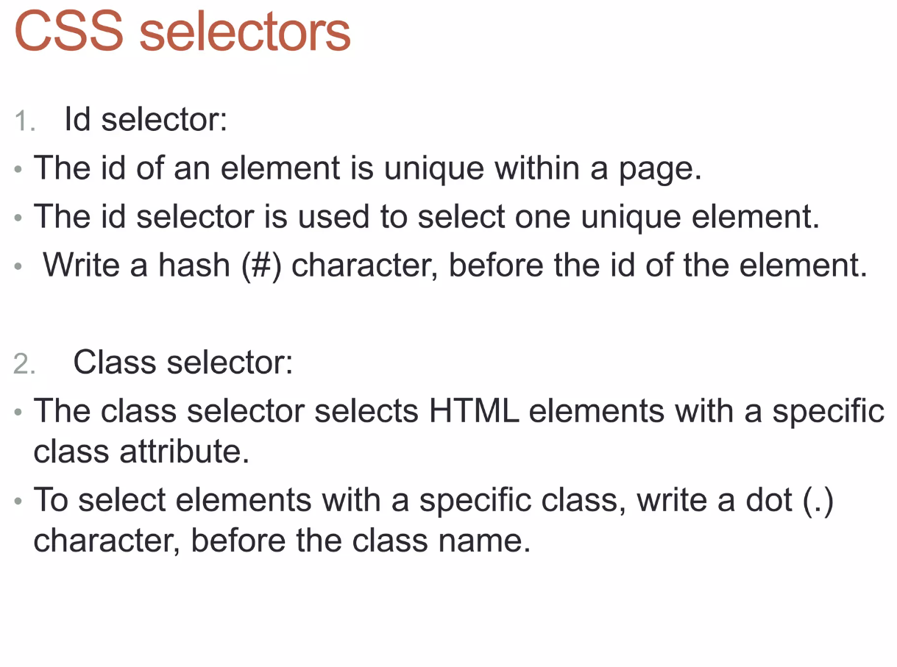

Slide 32
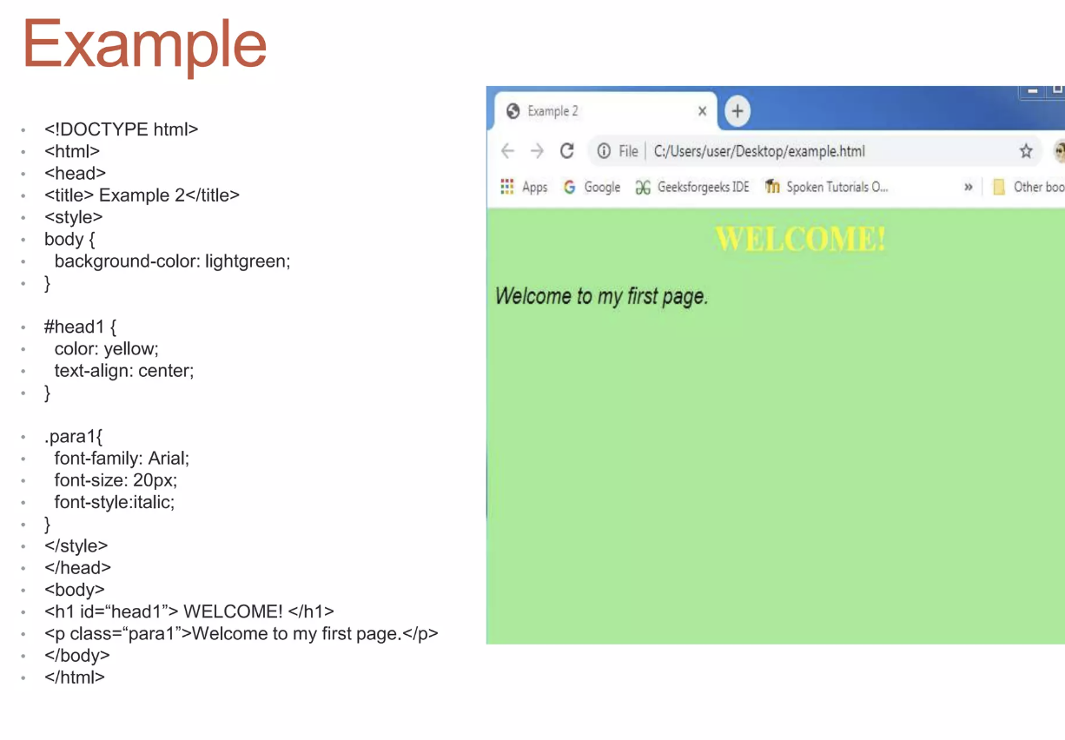

Slide 33
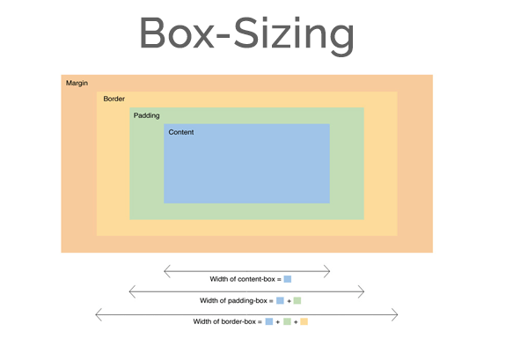
Box Model
It is important to note that by default any width and height specified to an element will not take into account its margin, so a div with width 100px and margin 10px will measure 120px on the screen, not 100px.
This could be a problem breaking your layout.
You can change this behaviour changing the box model of the element so the width uses the outmost border:
div { box-sizing: border; }

Slide 34
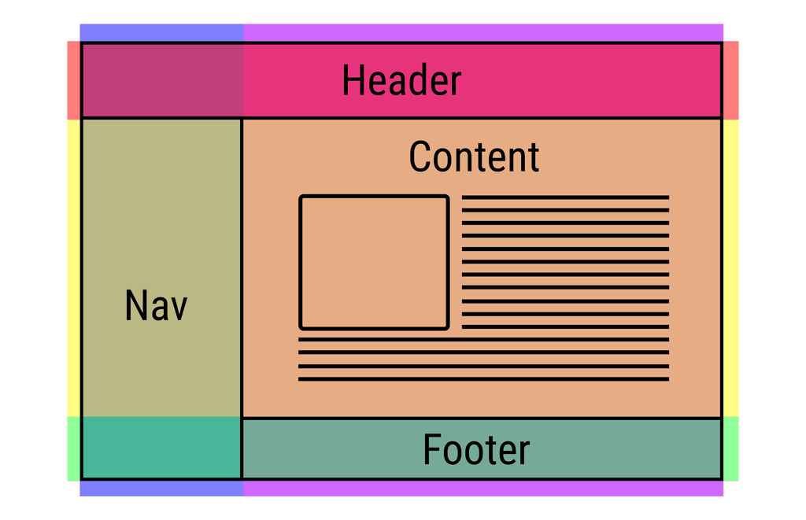
Layout
One of the hardest parts of CSS is constructing the layout of your website (the structure inside the window) .
By default HTML tends to put everything in one column, which is not ideal.
There has been many proposals in CSS to address this issue (tables, fixed divs, flex, grid, …).

Slide 35
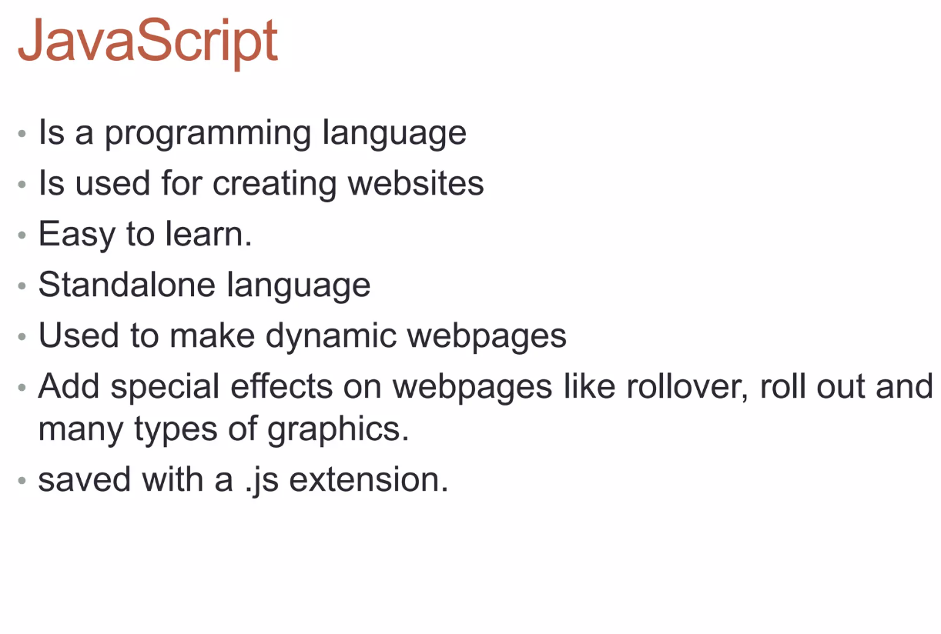

Slide 36
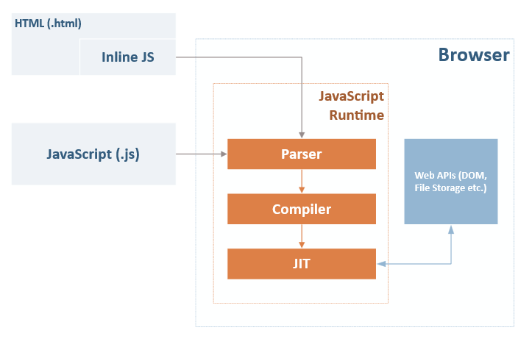
Javascript Interactivity
Once the web was already being used they realize people wanted to interact with the websites in a more meaningful way.
So they added an Interpreter to execute a script language that could modify the content of the web dynamically.
Brendan Eich was tasked to develop it in one week and it has become one of the most important languages.

Slide 37
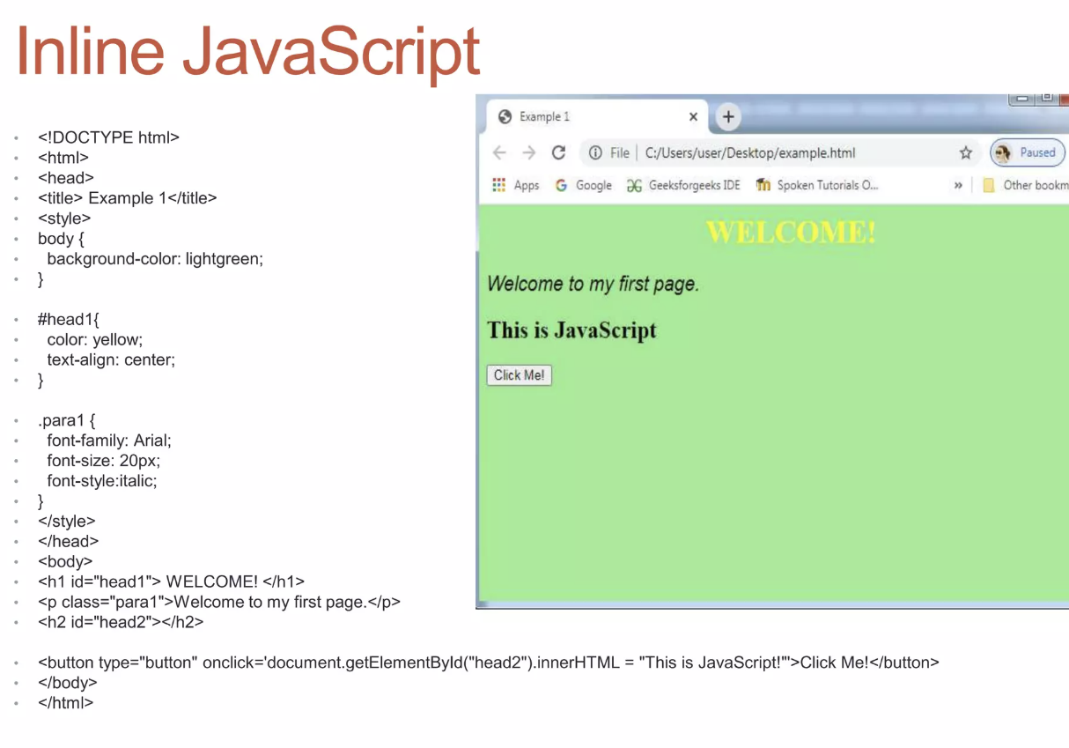

Slide 38
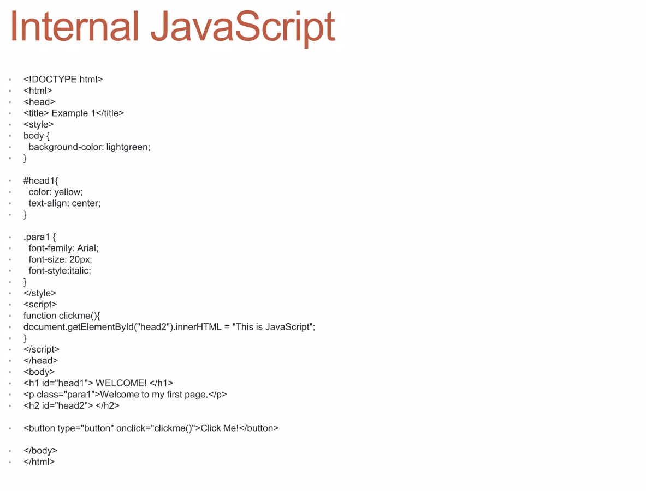

Slide 39

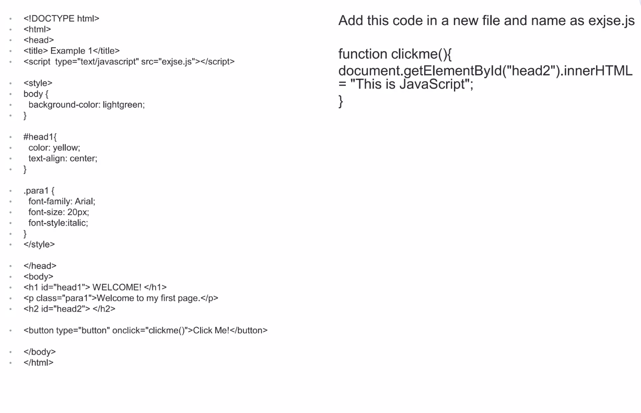

Slide 40


